Slide 1
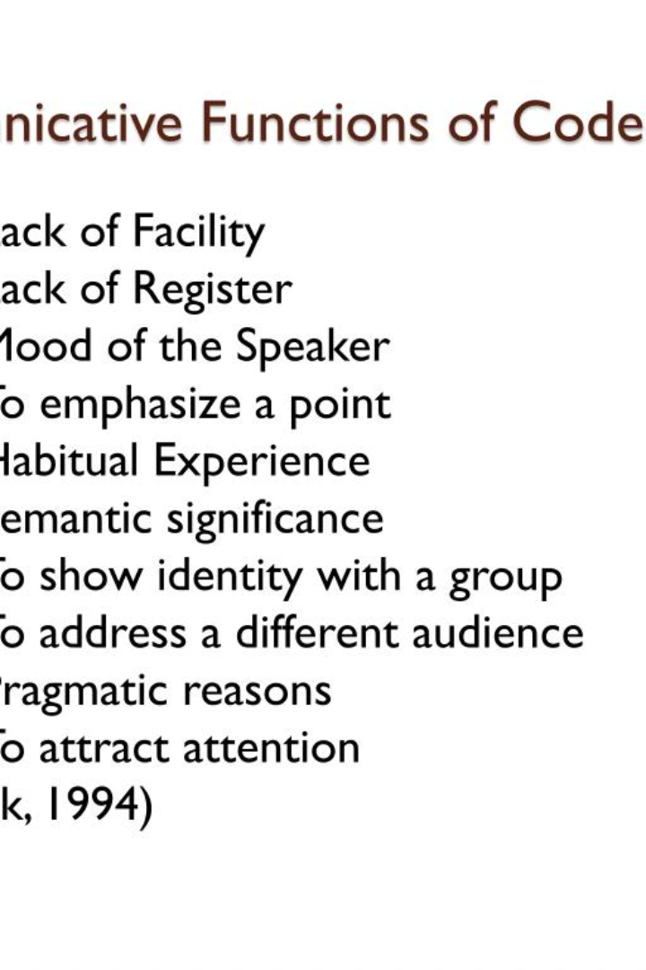


Introduction to Functions
In this presentation, we will explore the fundamentals of functions, including call by value and call by reference, returning and non-returning value functions, parameterized and non-parameterized functions, and the concept of function overloading. Let's dive in!
by Dr Drunk

Slide 2

What is a Function?
Functions are blocks of code that perform specific tasks. They help make our code more modular, readable, and reusable. By encapsulating a set of instructions, functions enable us to break down complex problems into smaller, manageable parts.

Slide 3

Call by Value and Call by Reference
1
Call by Value
2
Call by Reference
When using call by value, a copy of the value being passed to a function is created. Any changes made to the parameter inside the function do not affect the original value.
In call by reference, a reference to the memory location of the variable is passed to the function. Any modifications made to the parameter inside the function will reflect in the original value.

Slide 4
Returning and Non-Returning Value Functions
Returning Value Functions
Non-Returning Value Functions
Returns a value to the caller using the return statement. This allows the function to compute a result that can be further used in the program.
Also known as void functions, do not return a value. They are used when the task is to execute a specific set of instructions without producing an output.

Slide 5

Parameterized and Non-Parameterized Functions
1
Parameterized Functions
Accept one or more parameters that provide input values for the function to work on. These parameters allow functions to be more flexible and reusable.
Non-Parameterized Functions
2
Do not take any parameters and operate solely on information within the function body. Useful for simple tasks or calculations.
3
Difference
The main difference between parameterized and non-parameterized functions lies in the ability to pass input values and make functions reusable.

Slide 6
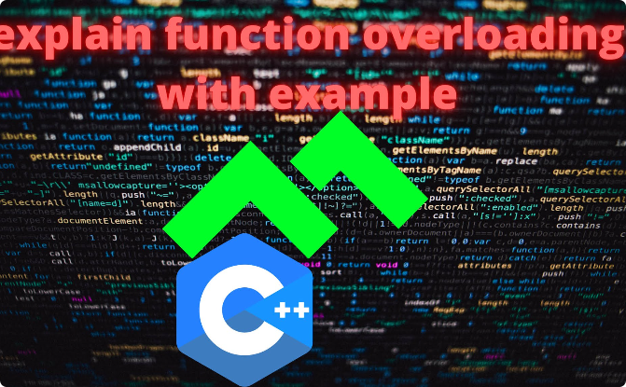
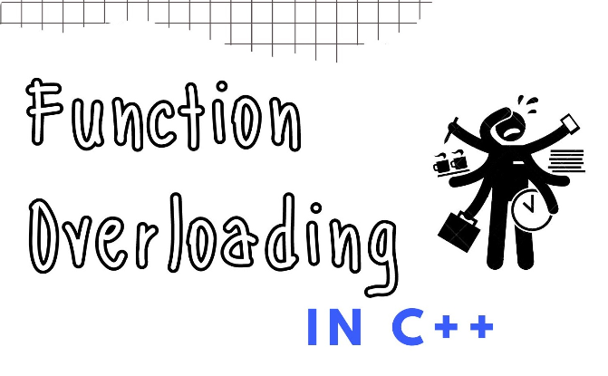
Function Overloading
What is Function Overloading?
Benefits and Examples
Function overloading allows us to define multiple functions with the same name but different parameters. The appropriate function is determined based on the supplied arguments.
By overloading functions, we can create variation in functionality without polluting the code with many function names. For example, we could have an "add" function that adds integers or floating-point numbers.

Slide 7

Conclusion
In conclusion, functions are a fundamental concept in programming. Understanding the different types of functions and their purposes will enhance your ability to write efficient and reusable code. Keep exploring and leveraging functions!

